Slide 1

CSCA 5622 Final Project
Training a model to predict breast cancer diagnosis
Andrew Safran
Notes:
Hi, My name is Andrew Safran, and I will be presenting my final project for CSCA 5622. For this project, I worked on training a model to predict a breast cancer diagnosis

Slide 2
data
Imaging performed on cell nuclei from mass in breast tissue
Each nucleus had measurements taken at three points
Mean, Standard Error, and Worst (highest) value were calculated
30 Features, 569 Records
Radius
Perimeter
Area
Texture
Smoothness
Concavity
Compactness
Concave Points
Symmetry
Fractal Dimension
https://www.kaggle.com/datasets/uciml/breast-cancer-wisconsin-data
Notes:
First, I want to walk through the data that was used for the model. It came from UCI Machine Learning on Kaggle, and was comprised of patients who had masses found in breast tissue. For each patient, an image was taken on the nucleus of a cell from the mass. For each image, the following measurements were taken on three parts of the nucleus. (List them here). For each category, the mean, SE, and worst (or highest) were calculated, and each of those calculations became a feature in the dataset. With the ten measurement types and three calculated features per measurement, there were 30 features in the dataset with 569 observations

Slide 3
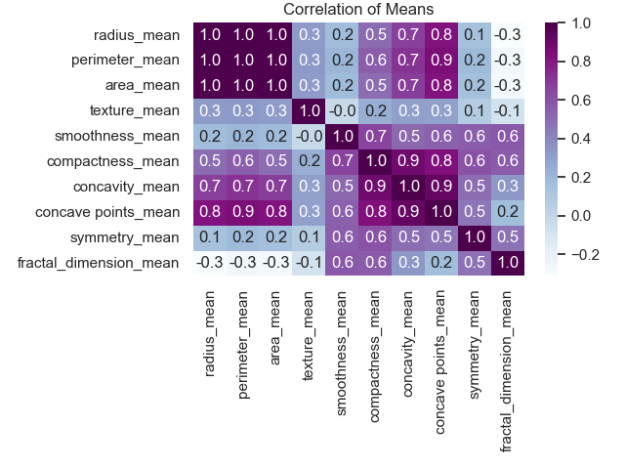
Exploratory Analysis
Variables grouped by statistic
Mean vs SE vs Worst
Correlations within groups
Pairplot for mean values
Notes:
To start my exploratory analysis, I decided to group together the features based on what statistic they represented, meaning mean, SE, or worst. I generated a heatmap of the correlation matrix within each group. Here you can see the correlations of all of the measurement means. I’ve highlighted a few key areas. First is the correlations between radius, perimeter, and area. This is where the correlations were the strongest, which makes sense because all three are directly related as measures of the size of the nucleus. Similarly, compactness, concavity, and number of concave points also had strong correlation. This also makes sense because they are all measures of the shape of the nucleus. There was also some moderately strong correlation between the size-related measurements and the concavity and concave points measures. So at first this was a little surprising, but again it could make sense as a larger nucleus would have more room to have more concave points.

Slide 4
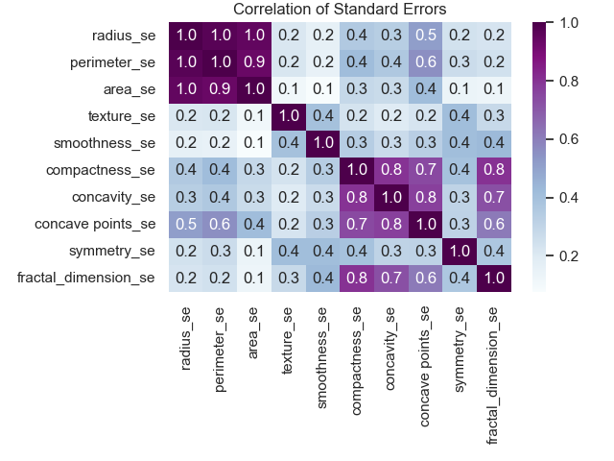
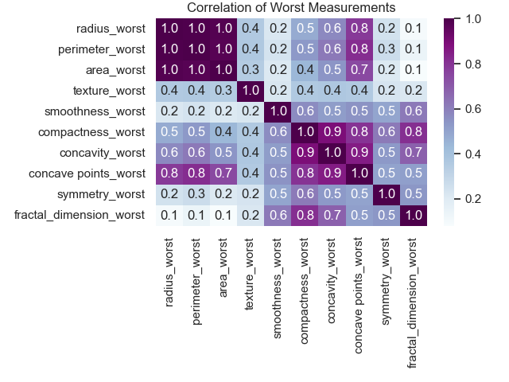
Notes:
Here we have the same correlation heatmaps for the Standard error measures and the worst measures. For standard errors, the size variables still maintain their high correlation, as well a the shape variables, but you may notice that the standard error for concave points no longer appears to have significant correlation with the standard errors of the size measurements. On the right, with the worst measurements, you’ll see that correlation has returned, although potentially not quite as strong as it is for the means.

Slide 5
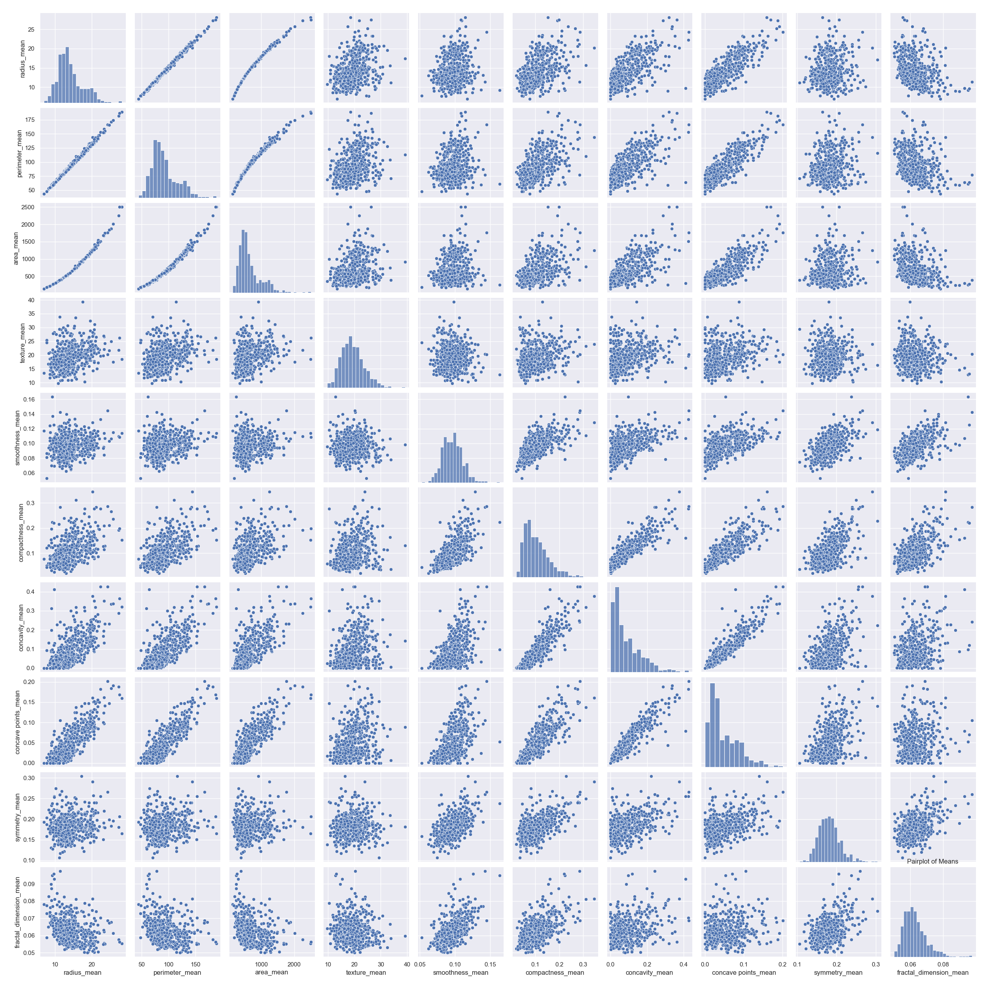
Notes:
Finally, I generated a pairplot for the mean measurements. At first I was surprised at just how strict the correlations were for the size measures, but it makes sense that radius and perimeter have a linear relationship, because the formula for a circle’s perimeter involves the radius. The same is true for the binomial relationship between the radius and area measures, because the radius is squared in the area formula for a circle.
I’ve also highlighted the same areas that I discussed on the heatmap, and you can see the same string correlations when the datapoints are plotted visually.

Slide 6
Model selection
Random Forest
Four models compared with different parameters:
Max depth: 3, Feature selection: Square Root
Max depth: 5, Feature selection: Square Root
Max depth: 10, Feature selection: Square Root
Max depth 10: Feature selection: Logarithmic
Notes:
I felt that the data was a good candidate for a decision tree ensemble method, and I ended up selecting the Random Forest due to the high degree of correlation that was noted among a number of the variables. As we discussed in the class, the Random Forest is a good way to de-correlate the tree, allowing some variables that may have significance to get out from under the shadow of other variables that may appear to be better. I utilized the RandomForest class that we created in the Ensemble assignment, and I decided to test it out with a few tweaks to the decision tree parameters.
First, I used a max depth of 3 nodes per tree using the square root to determine the number of features each tree would use.
Next, I used a max depth of 5 nodes with the square root method
The third tree was a max depth of 10, still using the square root
Finally, with the max depth of 10, I tried using the logarithmic method of selecting the number of features

Slide 7
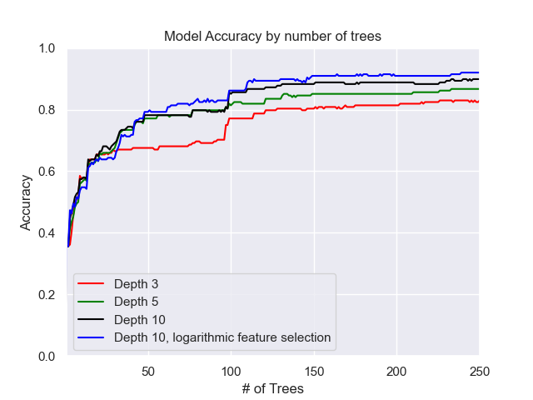
Results
Max Depth 10 with logarithmic selection performed best
Accuracy of 92% on test data
Notes:
As each Random Forest grew, I calculated the accuracy of their predictions and compared them on the plot to the right. As you can see, each of the classifiers started off with pretty low accuracy until they had a few dozen trees involved. The classifier with depth 3 seemed to plateau pretty early on, but it did gain a significant boost in accuracy right before hitting 100 trees. Interestingly, the other classifiers had an increase in accuracy around that point as well. Overall, the forest with a maximum depth of 10 and the logarithmic feature selection proved to be the most accurate. On the test data, it was able to correctly predict whether or not the mass was malignant with an accuracy of 92%.

Slide 8
Further analysis
How to visualize a Random Forest
How to find the most important features
Individually score each tree in the Random Forest
Keep track of the most accurate trees
Notes:
As we learned in class, there are some major drawbacks to using a Random Forest. Because the model does not settle on a single decision tree classifier, it is not great for providing a flowchart style visualization to help make decisions based on the model. This type of flowchart would ordinarily be extremely helpful for a medical professional hoping to use the model’s findings to determine an appropriate diagnosis.
It’s also hard to use a Random Forest to gain more general insight into the data. Again, because there is no single tree, you can’t see what features tend to be the best separators, and which end up being relatively insignificant.
In an attempt to get around these issues, I modified the Random Forest class so that when predictions are made, each of the individual trees had their predictions stored, and were scored against the test data. By doing this, I as able to access the individual Decision Trees that make up the Random Forest, and access them as one would with a single decision tree.

Slide 9
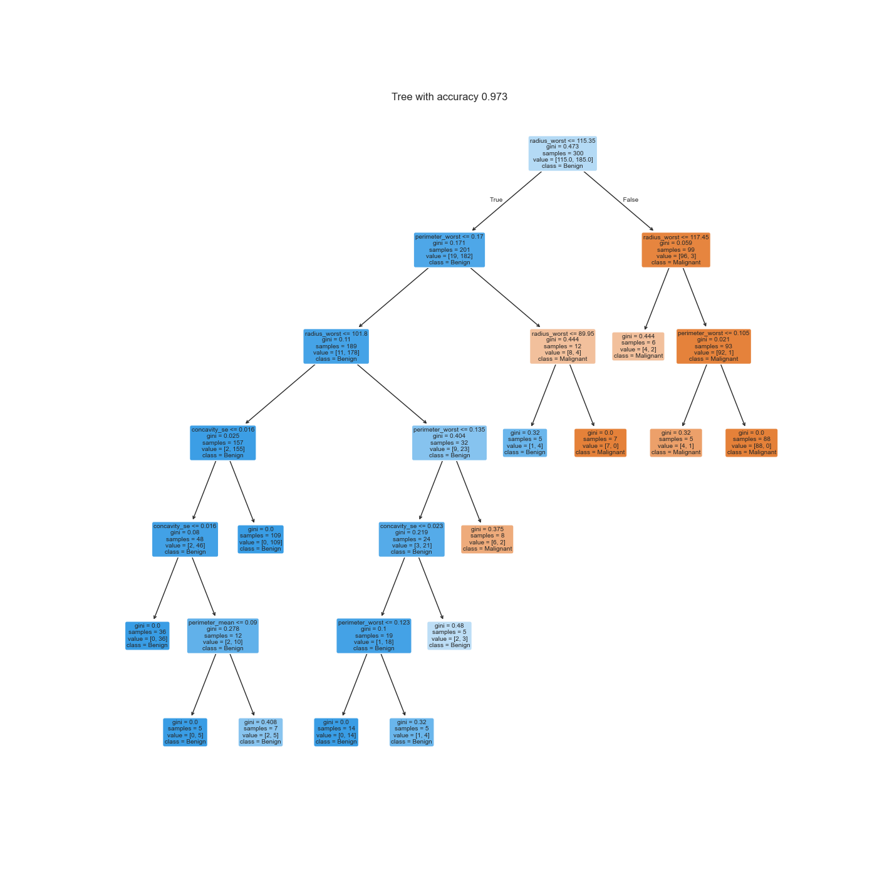
Notes:
This is the most accurate tree from the model. It’s a little hard to see due to the large depth. The blue nodes represent a benign diagnosis, while the orange nodes represent a malignant diagnosis. The saturation of the color represents the confidence in the prediction. Each of the red circles is a node that splits on the ‘radius_worst’ feature. Given the number of splits using that feature, including the root node, it would make logical sense to conclude that it is one of the more useful features for determining a diagnosis. In fact, I analyzed the top three most accurate trees, and radius_worst was the root node for all three, and it was used commonly throughout them all.
This tree was notably more accurate than the ensemble, which could be worth some further investigation. On one hand, it could be a coincidence that trees emphasizing radius_worst were well suited to the test data that was used. On the other hand, it’s possible that radius_worst truly is the best predictor for whether or not a mass is cancerous. In that case, the use of an ensemble to reduce variance could have introduced too much bias, and negatively impacted the model’s overall predictive ability.

